Slide 1

User Engagement Analysis For
RESTAURANT SUCCESS

Slide 2
About YELP
Yelp is a web and mobile platform that functions as a crowd-sourced local business review site. Users can submit reviews, photos, and tips about
businesses, while also browsing information and ratings left by others.

Slide 3
AGENDA
Problem Statement Research Objectives Hypothesis
Data Overview Analysis and Findings Recommendations

Slide 4
Problem Statement
In a competitive market like the restaurant industry, understanding the factors that influence business success is crucial for stakeholders. Utilizing the Yelp dataset, this project aims to investigate the relationship between user engagement (reviews, tips, and check-ins) and business success metrics (review count, ratings) for restaurants.

Slide 5
Research Objectives
Quantify the correlation between user engagement (reviews, tips, check-ins) and review count/average star rating.
Analyze the impact of sentiment on review count and average star rating.
Time Trends in User Engagement

Slide 6


Hypothesis
vels of user engagement (more reviews, tips, and ch -i with higher review counts and ratings for restaurants
sentiment expressed in reviews and tips contributes overall ratings and review counts for restaurants.
Consistent engagement over time is positively associa sustained business success for restaurants.
wi

Slide 7

Data Overview
set is a subset of Yelp and has information about bus ss metropolitan areas in the USA and Canada.
inal data is shared by Yelp as JSON files.
The five JSON files are business, review, user, tip and checkin The JSON files are stored in the database for easy retrieval of d

Slide 8

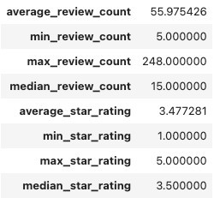
Analysis and Findings
Out
ble
k businesses, 35k are restaurants business and are ope
wing distribution of business success metrics (review ou ge rating):

Slide 9

Higher ratings do not guarantee a higher review count, or vice versa.
Success of Restaurants is not solely determined by ratings or review counts.
Review count reflects user engagement but not necessarily overall customer satisfaction or business performance.

Slide 10
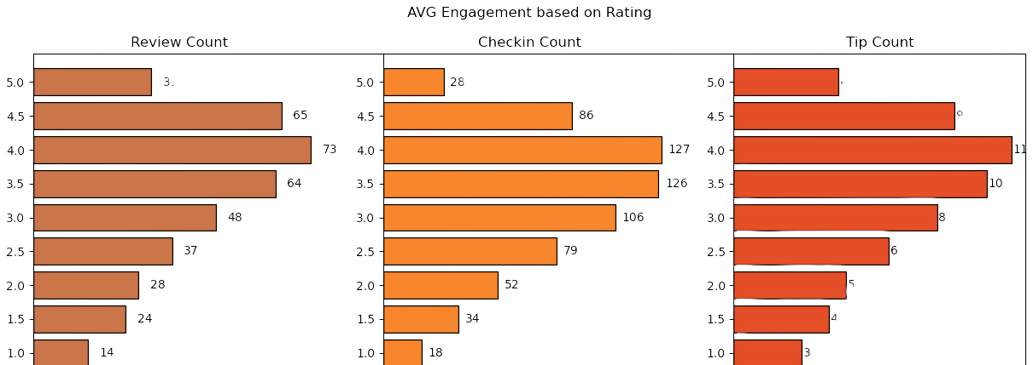
Do restaurants with higher engagement tend to have higher ratings?
hows a general increase in average review, check-in, and tip ove from 1 to 4 stars.
rated 4 stars exhibit the highest engagement and shows ng above 4.
engagement at 5.0 stars might suggest either a sat here fewer customers feel compelled to add their reviews, or a sele nly a sma satisfied
dience frequents these tablishments.

Slide 11
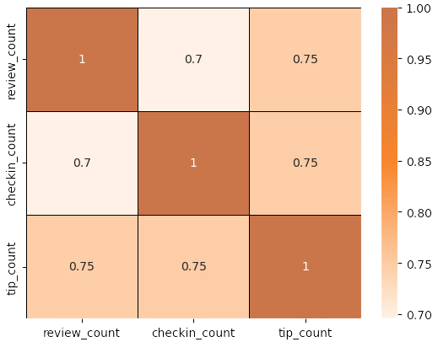
Is there a correlation between the number of reviews, tips, and check-ins for a business?
se c lations suggest that user engagement across different s, tips, and check-ins) is interlinked; higher activity in one area
with higher activity in others.
should focus on strategies that types of user engagement, as
creases in one type of engagement are likely drive increases in others, enhancing overall
sibility and interaction with customers.

Slide 12
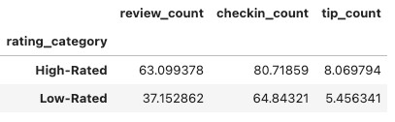
Is there a difference in the user engagement between high- rated and low-rated businesses?
ndicates a clear correlation between higher ratings and incr across reviews, tips, and check-ins.
underscores the importance of maintaining high servic s these appear to drive more reviews, check-ins, and ti
itical metrics of customer engagement and satisfaction.

Slide 13
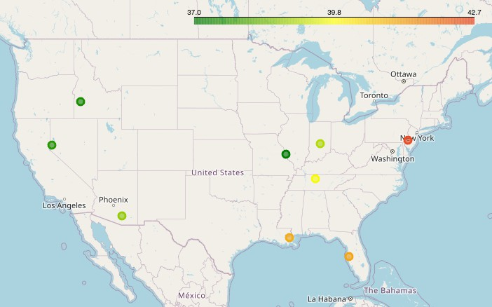
How do the success metrics of restaurants vary across different states and cities?
lphia emerges as the top city highest success score, combination of high ratings ser engagement.
ollowing Philadelphia, Tampa, dianapolis, and Tucson rank among e top cities with significant success ores, suggesting thriving restaurant
scenes in these areas.

Slide 14
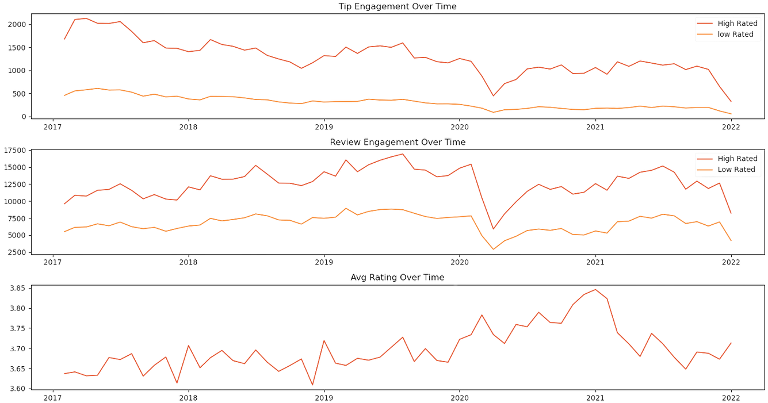

Are there any patterns in user engagement over time for successful businesses compared to less successful ones?
Successful
businesses,
Drop due to COVID
particularly those with higher
ratings (above 3. 5), exhibit
consistent increasing over time.
and possibly
user engagement
High rated restaurants maintain a steady or growing level of user engagement over
time, reflecting
ongoing
and
customer interest
satisfaction.

Slide 15


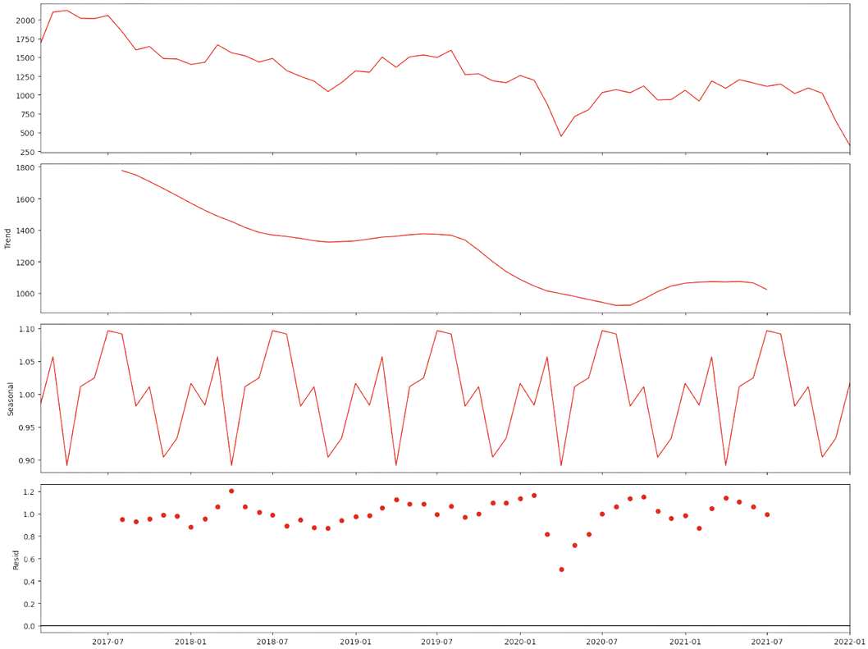
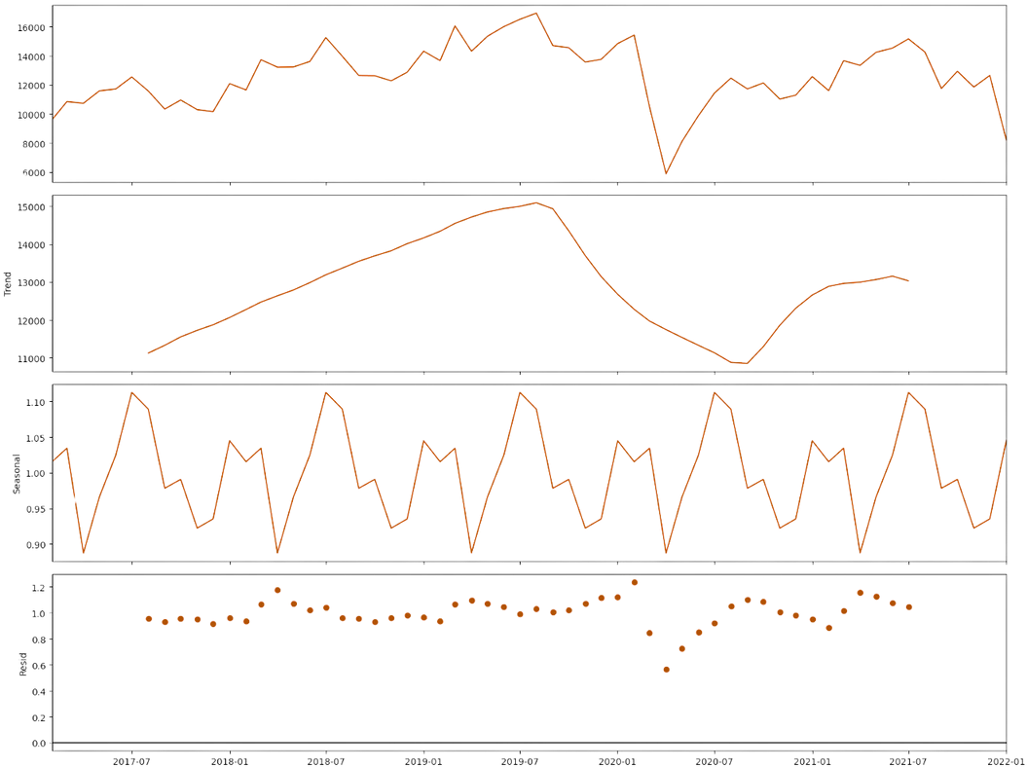
Trend and Seasonality Analysis
Downward Trend
Upward Trend
Year Starting and Ending (Nov - Mar) is Highly Engaging

Slide 16

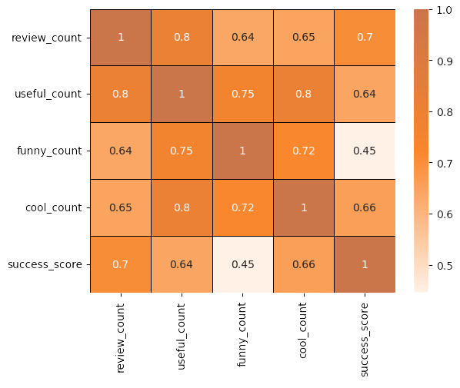
How does the sentiment of reviews and tips (useful, funny, cool) correlate with the success metrics of restaurants?
“useful," "funny," and "cool" are attributes associated with user reviews. They represent the feedback provided by users about the usefulness, humor, or coolness of a particular review.
Higher counts of useful, funny, and cool reviews suggest greater user engagement and satisfaction, which are key factors contributing to a restaurant's success.

Slide 17
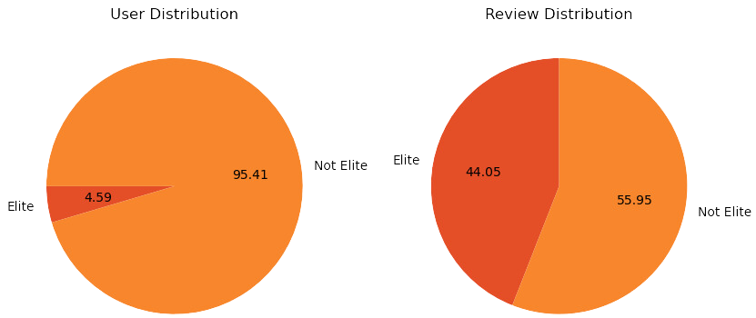
Is there any difference in engagement of elite users and non elite users?
Elite users are individuals who have been recognized and awarded the "Elite" status by Yelp for their active and high-quality contributions.
Elite users, despite being significantly fewer in number, contribute a substantial proportion of the total review count compared to non-elite users.
Establishing a positive relationship with elite users can lead to repeat visits and loyalty, as they are more likely to continue supporting businesses they have had good experiences with.

Slide 18
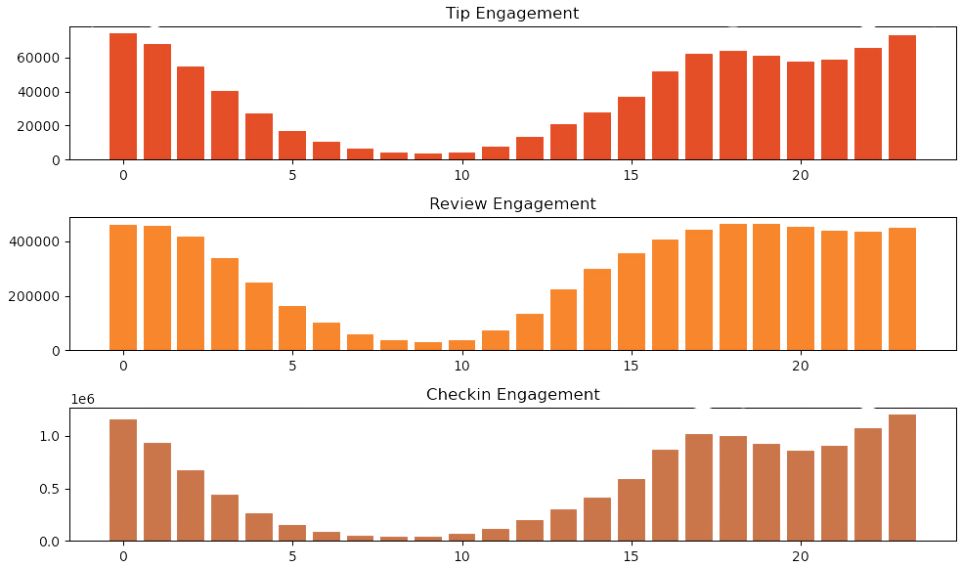
Busiest Hours
The busiest hours for restaurants, based on user engagement, span from 4 pm to 1 am.
Knowing the peak hours allows businesses to optimize their staffing levels and resource allocation during these times to ensure efficient operations and quality service delivery.
The concentration of user engagement during the evening and night hours suggests a higher demand for dining out during these times, potentially driven by factors such as work schedules, social gatherings, and leisure activities.

Slide 19
Recommendations
Utilizing insights from the analysis of various metrics such as user engagement, sentiment of reviews, peak hours, and the impact of elite users, businesses can make informed decisions to drive success.
Collaborating with elite users and leveraging their influence can amplify promotional efforts, increase brand awareness, and drive customer acquisition.
Businesses can adjust their operating hours or introduce special promotions to capitalize on the increased demand during peak hours.
Less successful businesses may need to focus on strategies to enhance user engagement over time, such as improving service quality, responding to customer feedback.
Cities with high success scores presents opportunities for restaurant chains to expand or invest further.

Slide 20
Thank You

